Slide 1




Filtering Noisy Audio
Signals & Systems Lab Project
Prepared By:
Ali Asghar (21PWCSE2059)
Suleman Shah (21PWCSE1983)
Shahzad Bangash (21PWCSE1980)

Slide 2

Overview:
Introduction
Problem Statement
Project Source
Tools used in the project
Project Flow Diagram
Methodology
Signal Analysis
Filter Design
Impulse Response Calculation
Filtering process
Results
Conclusion
References
Page #3
Page #4
Page #5
Page #6
Page #7
Page #7
Page #8
Page #11
Page #14
Page #16
Page #18
Page #19
Page #20

Slide 3
Introduction:
The project aims to analyze and process a noisy audio signal using filtering techniques to attenuate unwanted noise and improve audio quality. It involves exploring
frequency characteristics
designing filters
analyzing their response
and evaluating filtered audio outputs.

Slide 4
Problem statement:
This project addresses the issue of noise in audio signals, which diminishes quality and impacts the listening experience. The objective is to use filtering techniques to eliminate or minimize noise and improve the overall audio quality.

Slide 5
Project Source:
The idea of the project is taken from the github account of alirezajaberirad[1].

Slide 6
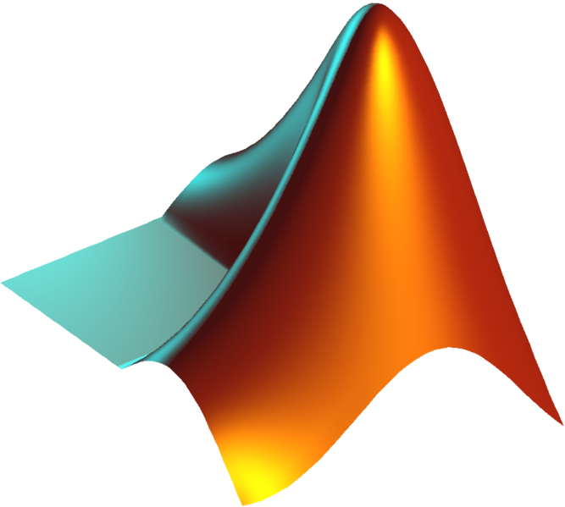
Tools Used:
MATLAB[2]: A software tool widely used for processing and analyzing discrete data, including signal processing applications and computational mathematics.
Fourier transform[3]: Used to decompose data represented as a function of time or space into frequency components.
fft function[4][5]: Implements a fast Fourier transform algorithm in MATLAB, reducing computational cost compared to other direct implementations.
conv and filter functions: Useful tools for modifying the amplitude or phase of input data using a transfer function.
Figure 1,
MATLAB Logo
6

Slide 7
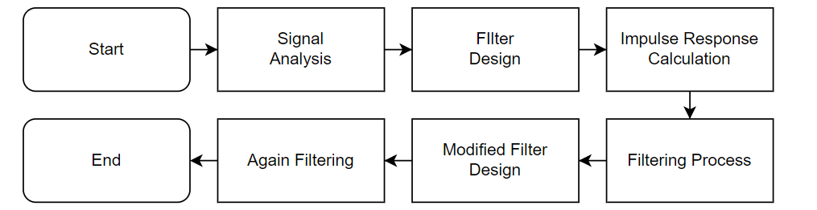
Methodology:
The project methodology comprises the following steps:
Figure 2, Flowchart of Program

Slide 8
Step 1, Signal Analysis:
Read the noisy audio signal and extract its sampling frequency.
Apply the Fast Fourier Transform (FFT) to analyze the frequency content and phase information of the signal.
Visualize the magnitude spectrum and phase spectrum of the signal.

Slide 9
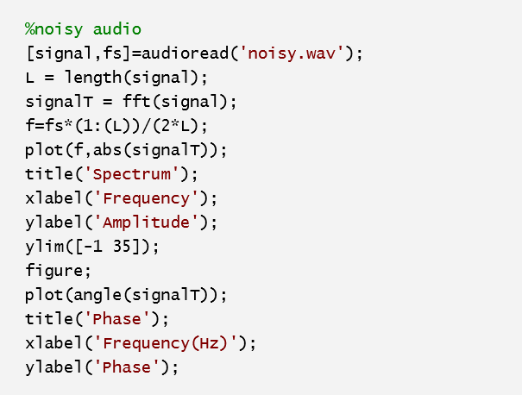
Step 1, Signal Analysis (Cont.):
Code:
Figure 3.1, Signal Analysis Section Code

Slide 10
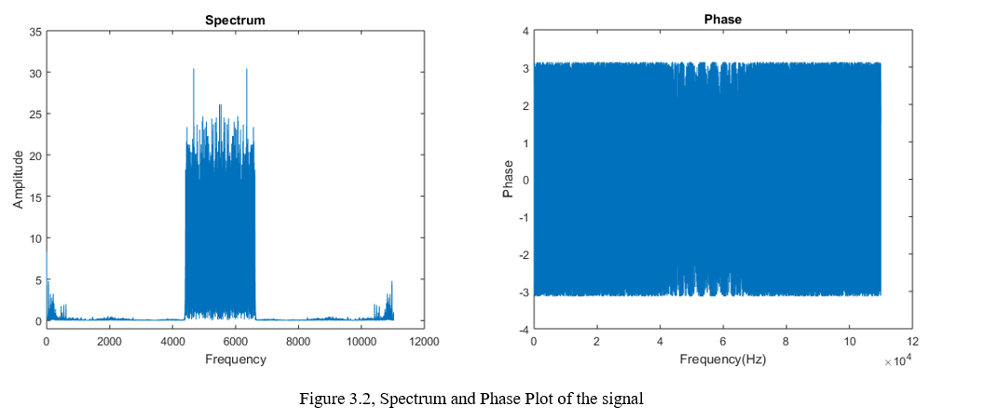
Step 1, Signal Analysis (Cont.):
Output:

Slide 11
Step 2, Filter Design:
Design an initial filter by specifying the filter coefficients.
Compute the frequency response of the initial filter using the ‘freqz’ function.
Plot the magnitude and phase spectra of the filter's frequency response.
Visualize the poles and zeros of the filter using the ‘fvtool’ function.

Slide 12
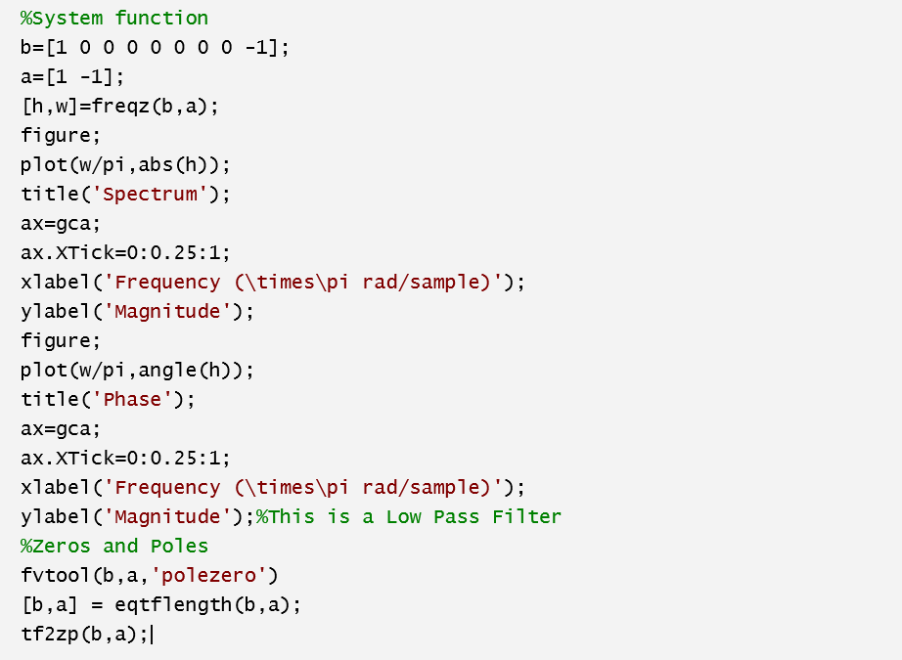
Step 2, Filter Design (Cont.):
Code:
Figure 4, System Design Section Code

Slide 13
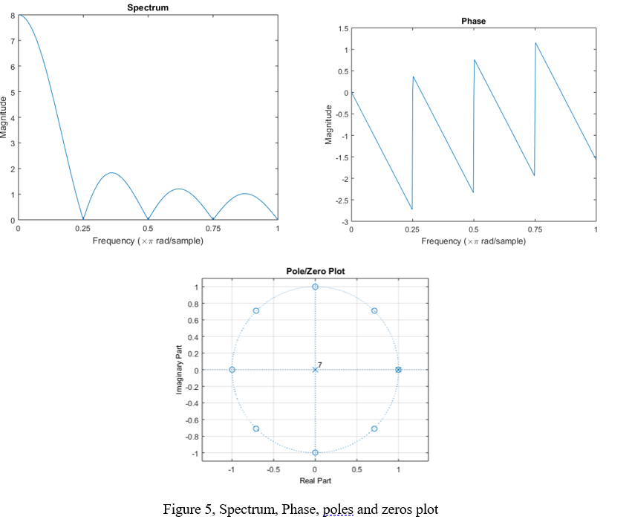
Step 2, Filter Design (Cont.):
Output:
13

Slide 14
Step 3, Impulse Response Calculation:
Calculate the impulse response of the initial filter using the ‘impz’ function.
Plot the impulse response to analyze its characteristics and determine its length.

Slide 15
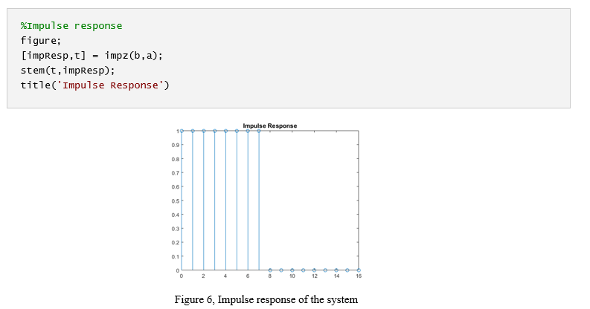
Step 3 Impulse Response Calculation (Cont.):
Code and Output:

Slide 16
Step 4, Filtering Process:
Calculate the impulse response of the initial filter using the ‘impz’ function.
Plot the impulse response to analyze its characteristics and determine its length.

Slide 17
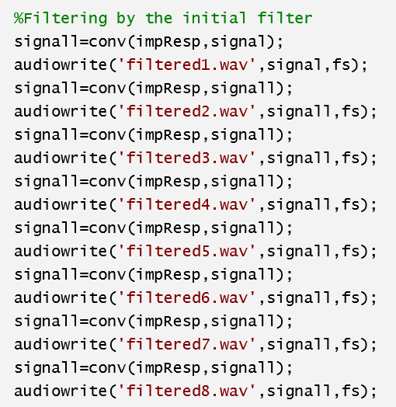
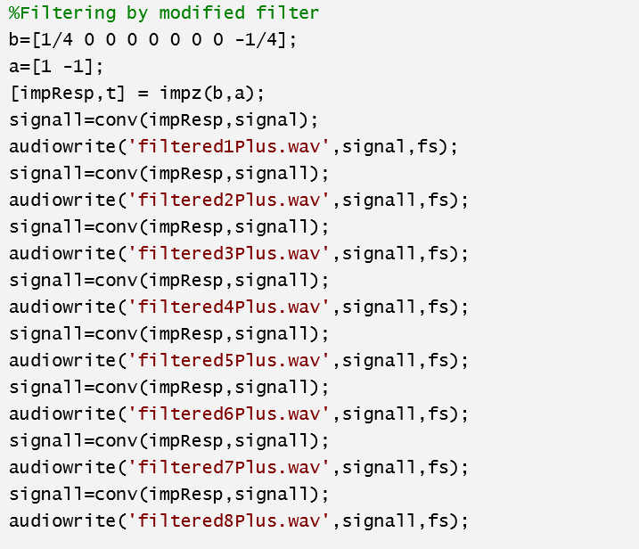
Step 4, Filtering Process (Cont.):
Code:
Figure 7, Filtering Process Section Code

Slide 18
Step 5, Results:
The project yielded the following results:
Frequency spectra and phase spectra of the original noisy audio signal.
Frequency response of the initial filter, including magnitude and phase spectra.
Impulse response of the initial and modified filters.
Filtered audio signals at different stages of filtering.

Slide 19
Conclusion:
In conclusion, this project effectively utilized filtering techniques to reduce noise and enhance the audio quality of a noisy signal. The analysis of frequency spectra, filter characteristics, and impulse responses provided valuable insights, highlighting the significance of audio filtering techniques in improving audio signals.

Slide 20
References:
Alirezajaberirad, Filtering Noisy Audio, https://github.com/alirezajaberirad/Signals-and-Systems/tree/main/CA2%20-%20Filtering%20Noisy%20Audio
MATLAB, https://www.mathworks.com/products/matlab.html
MathWorks, Fourier Analysis and Filtering, https://in.mathworks.com/help/matlab/fourier-analysis-and-filtering.html?s_tid=CRUX_lftnav
Fast Fourier Transform, https://en.wikipedia.org/wiki/Fast_Fourier_transform#:~:text=A%20fast%20Fourier%20transform%20(FFT,frequency%20domain%20and%20vice%20versa.
MathWorks, Fast Fourier Transform (FTT), https://in.mathworks.com/help/matlab/math/fourier-transforms.html

Slide 21
THANK YOU

